Slide 1
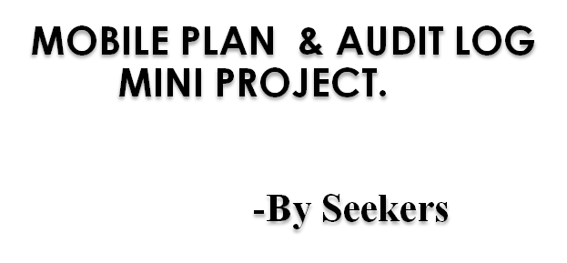

Slide 2
planning
Mobile Plan & Audit-Log Planning (Seekers)
Epic | Epic Name | Ticket ID | User Stories | Assigned To | Status | Start Date | End Date | Duration (In day)
1 | Rest API Creation in Spring Boot Application | MP-1 | Read By id Controller | Komal | Done | 25-Aug | 26-Aug | 2
 |  | MP-2 | Update Controller | Satyam | Done | 26-Aug | 29-Aug | 4
 |  | MP-4 | Delete Controller | Shubham | Done | 26-Aug | 29-Aug | 4
 |  | MP-5 | Update & Delete Service | Prathamesh | Done | 26-Aug | 29-Aug | 4
2 | UI and It's integration with Spring boot Application | MP-6 | Home Webpage & Create Webpage | Shubham | Done | 30-Aug | 5-Sep | 7
 |  | MP-7 | Search Webpage & Update By id Webpage | Prathamesh | Done | 30-Aug | 5-Sep | 7
 |  | MP-8 | Delete Webpage & View All Webpage | Satyam | Done | 30-Sep | 5-Sep | 7
 |  | MP-9 | Integration of Front end & Backend | Prathamesh & Shubham | Done | 6-Sep | 12-Sep | 7
 |  | MP-10 | About Us webpage | Pranjali | Done | 6-Sep | 12-Sep | 7
3 | Creation and Integration of Audit log with Mobile Plan | MP-11 | Backend Controller | Satyam | Done | 13-Sep | 16-Sep | 4
 |  | MP-12 | Backend Service | prathamesh | Done | 13-Sep | 16-Sep | 4
 |  | MP-13 | UI - View webpage | Pranjali | Done | 13-Sep | 19-Sep | 7
 |  | MP-14 | UI - Search Webpage | Komal | Done | 13-Sep | 19-Sep | 7
 |  | MP-15 | Overall Improvement | Shubham | Done | 16-Sep | 20-Sep | 2
4 | Documentation & Testcases | MP-16 | Postman JSON Collection | Pratik | Done | 21-Sep | 26-Sep | 6
 |  | MP-17 | Functional Test Cases & Rest Api Test Cases | Pratik | Done | 21-Sep | 26-Sep | 6
 |  | MP-18 | Defect(Bug) Report | pratik | Done | 21-Sep | 28-Sep | 8

Slide 3
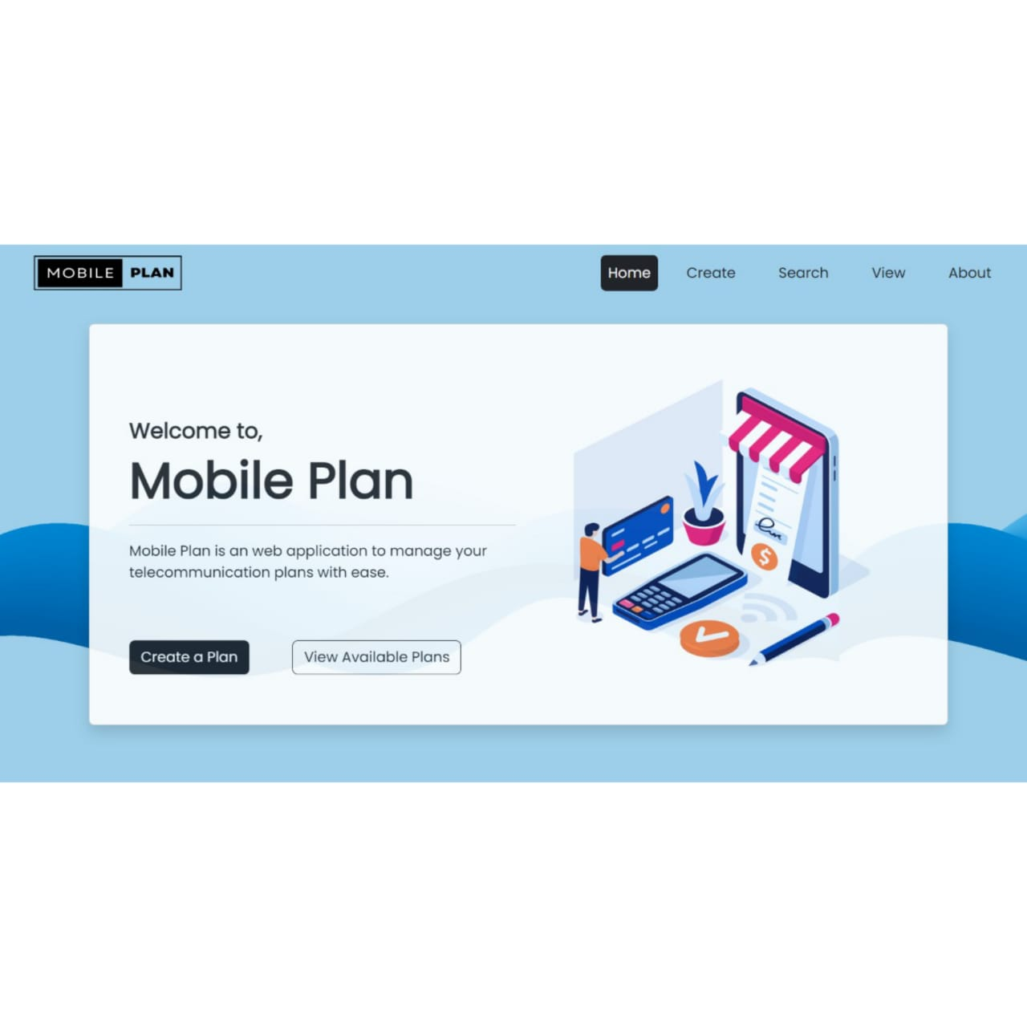
Design: Mobile Plan
With help of mobile plan
user will do following Operations:
Create a new plan
Search a plan
View all the present plan
Update and delete plan

Slide 4
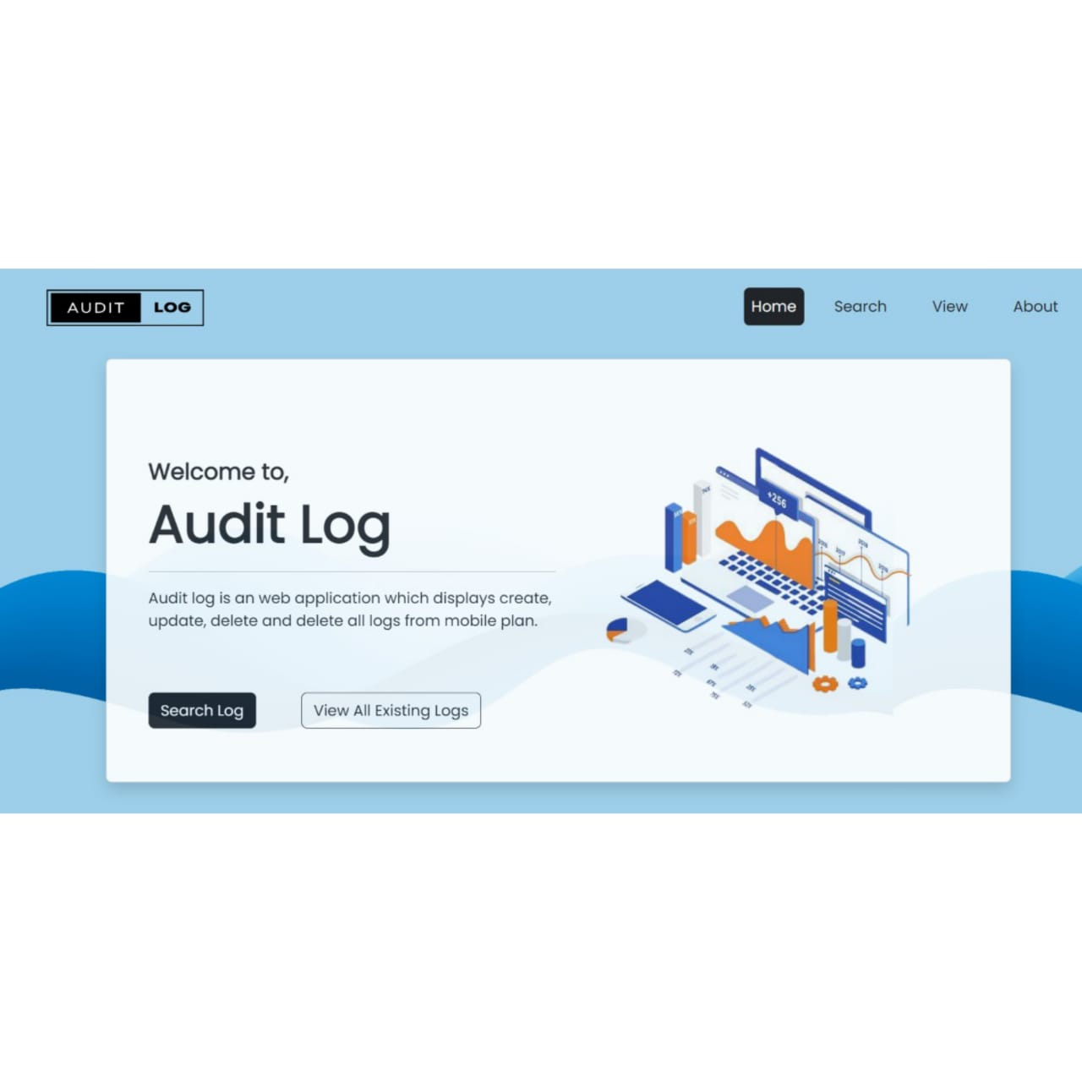
Design: Audit Log
Audit Log basically keep information of all transactions in Mobile Plan application such as
Operation type
Log of activity
Data and time

Slide 5


Design & Architecture
Mobile Plan
microservice
PORT : 8080
Mobile Plan
Database
PORT : 8081
Audit Log
microservice
User
Audit log
Database

Slide 6
Technology & Tools
Spring Tool suites.
Docker.
Git.
Sqlyog.
Postman.
Java.
MariaDB.

Slide 7
DETAILS:
Mobile Plan has various functionalities as follows:
•CREATE - This function allows user to add new mobile plans.
•GET ALL -This function allows user to get all the mobile plans.
•SEARCH - This function allows user to search the mobile plan.
•UPDATE - This function allows user to update the details of mobile plan.
•DELETE - This function allows user to delete the mobile plan.

Slide 8
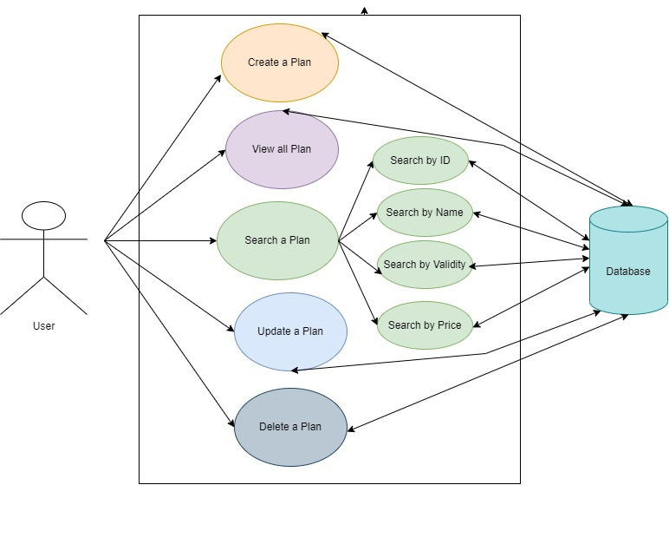
USE-CASE DIAGRAM

Slide 9
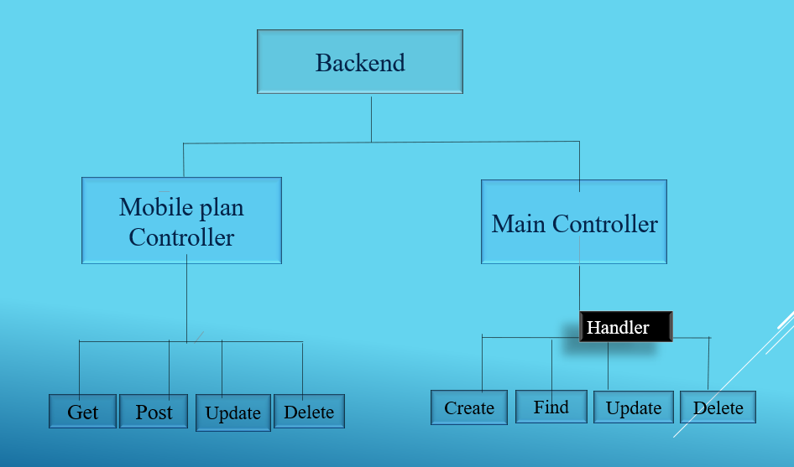
Backend

Slide 10
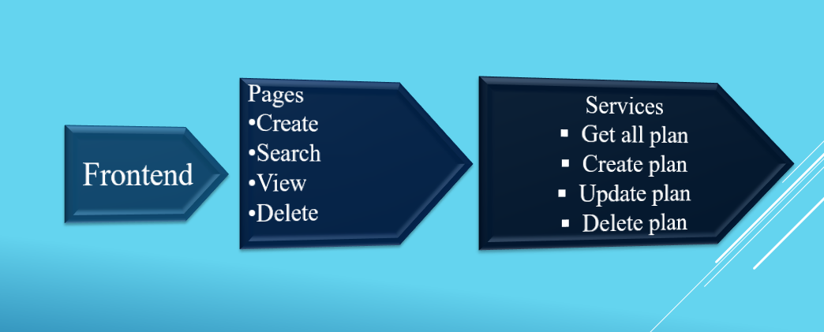
FRONTEND

Slide 11






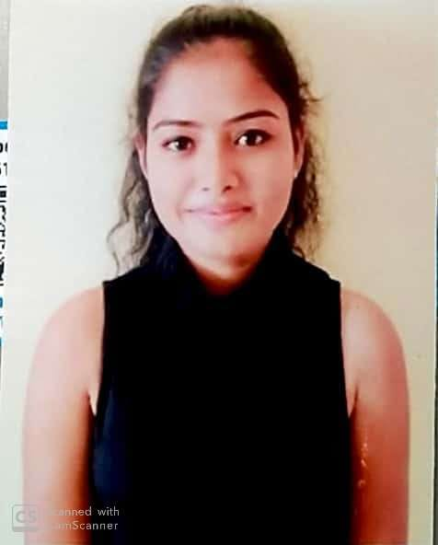
About us
Prathmesh Lakawade
Satyam Patel
Prateek Ambalkar
Komal Mohite
Shubham Shingare
Pranjali Mane

